Slide 1


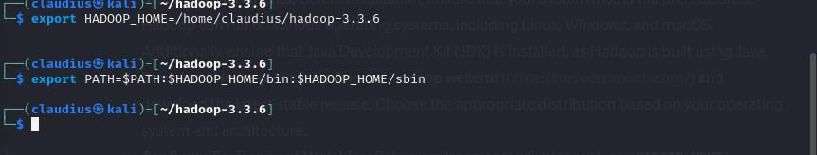
Section 2.1: Hadoop Installation
Hadoop, an open-source framework designed for distributed storage and processing of large datasets, is a cornerstone of big data analytics. Installing Hadoop typically involves several steps to ensure a smooth deployment. Here's a detailed guide on how to install Hadoop;
1. System Requirements: Before installation, ensure that your system meets the prerequisites. Hadoop can run on various operating systems, including Linux, Windows, and macOS. Additionally, ensure that Java Development Kit (JDK) is installed, as Hadoop is built using Java.
Section 2.2 Hadoop Setup/Use
1. Configure Environment Variables: Set up environment variables such as HADOOP_HOME, JAVA_HOME, and PATH. These variables are crucial for Hadoop to function correctly. Add the Hadoop bin directory to your system's PATH variable to execute Hadoop commands from any directory.
2. Download Hadoop: Visit the Apache Hadoop website (https://hadoop.apache.org/) and download the latest stable release. Choose the appropriate distribution based on your operating system and architecture.
wget https://downloads.apache.org/hadoop/common/current/hadoop-3.3.6-aarch64.tar.gz

Slide 2
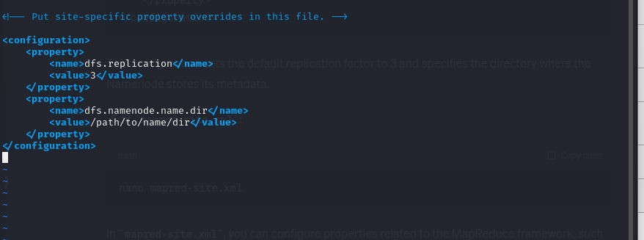
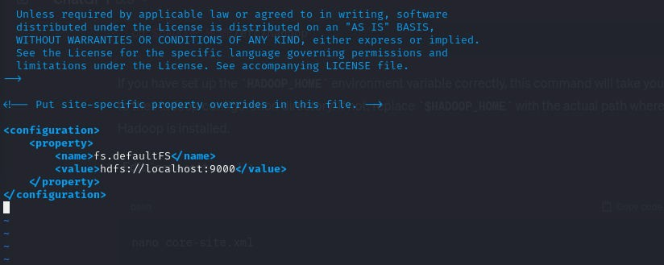
hdfs-site.xml
2. Edit Configuration Files: Navigate to the Hadoop configuration directory ($HADOOP_HOME/etc/hadoop) and modify essential configuration files like core-site.xml, hdfs-site.xml, and mapred-site.xml. These files define parameters such as file system settings, replication factors, and resource manager configurations.
core-site.xml

Slide 3
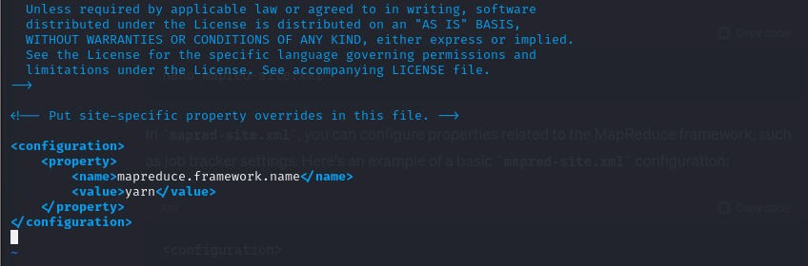
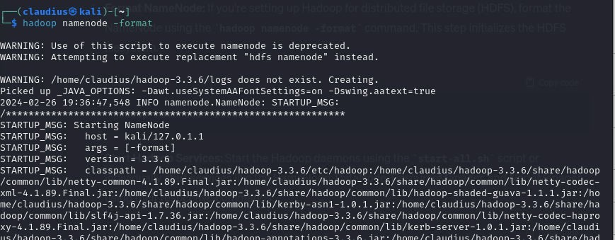
mapred-site.xml
3. Format NameNode: If you're setting up Hadoop for distributed file storage (HDFS), format the NameNode using the hadoop namenode -format command. This step initializes the HDFS filesystem.

Slide 4
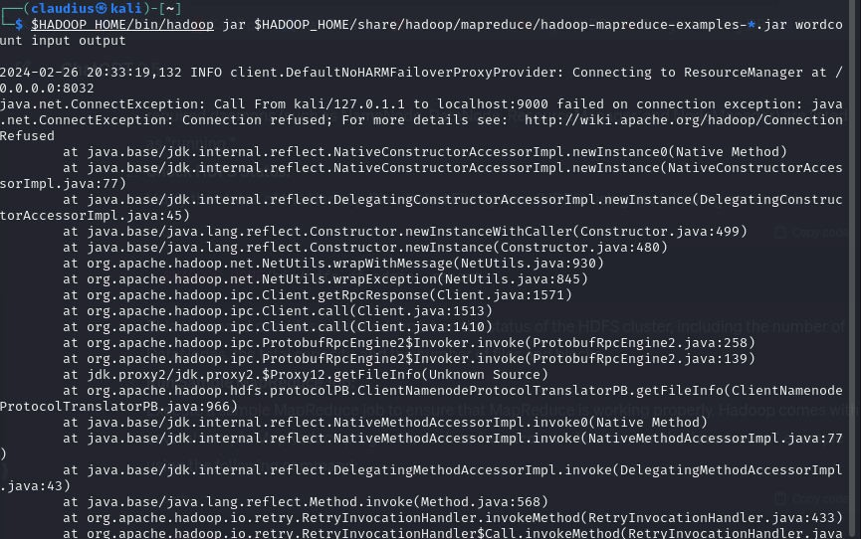
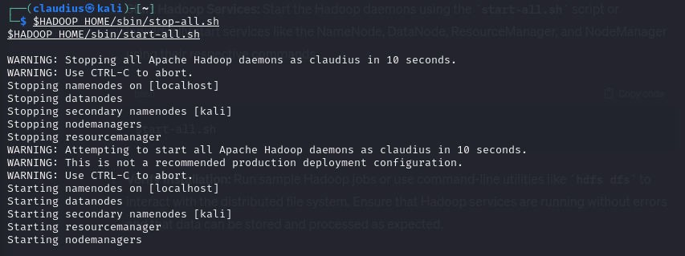
5. Verify Installation: Run sample Hadoop jobs or use command-line utilities like hdfs dfs to interact with the distributed file system. Ensure that Hadoop services are running without errors and that data can be stored and processed as expected.
4. Start Hadoop Services: Start the Hadoop daemons using the start-all.sh script or individually start services like the NameNode, DataNode, ResourceManager, and NodeManager using their respective commands.

Slide 5
Once Hadoop is installed, it's essential to understand how to set up and use it effectively. Here's a guide to getting started with Hadoop:
Understanding Hadoop Ecosystem: Familiarize yourself with the various components of the Hadoop ecosystem, including HDFS for storage, MapReduce for processing, YARN for resource management, and additional modules like Hive, Pig, and HBase for higher-level abstractions.
Data Ingestion: Decide how you'll ingest data into Hadoop. You can upload files directly to HDFS using commands like hdfs dfs -put, or leverage tools like Flume or Kafka for streaming data ingestion.
Data Processing: Write MapReduce jobs or utilize higher-level abstractions like Apache Spark or Apache Flink to process data stored in Hadoop. These frameworks offer efficient distributed processing capabilities for various use cases, from batch processing to real-time analytics.
4.Cluster Management: Monitor and manage your Hadoop cluster using tools like Apache Ambari or Cloudera Manager. These platforms provide centralized management interfaces for configuring, monitoring, and troubleshooting Hadoop clusters.
5.Security: Implement security measures such as Kerberos authentication, Access Control Lists (ACLs), and encryption to protect data stored in Hadoop. Secure your Hadoop cluster by restricting access to authorized users and securing communication channels.
6.Scaling: As your data grows, scale your Hadoop cluster horizontally by adding more nodes. Utilize features like Hadoop Federation or HDFS High Availability (HA) to ensure high availability and fault tolerance.
7.Optimization: Continuously optimize your Hadoop cluster for performance and efficiency. Tune parameters such as block size, replication factor, and JVM settings based on your workload characteristics. Additionally, consider data partitioning and indexing techniques to improve query performance in distributed data processing frameworks.

Slide 6
YARN: Yet Another Resource Negotiator (YARN) is a resource management framework in Hadoop that enables multiple data processing engines to run concurrently on the same cluster. YARN decouples resource management from job scheduling, allowing for more efficient resource utilization.
Ecosystem Integration: Hadoop has a vibrant ecosystem of tools and frameworks that extend its capabilities for various use cases. Tools like Apache Hive for data warehousing, Apache Pig for ETL (Extract, Transform, Load), and Apache Spark for in-memory processing are widely used alongside Hadoop.
Security: Hadoop provides robust security features to protect data stored in the cluster. It supports authentication mechanisms like Kerberos and role-based access control (RBAC), along with encryption for data at rest and in transit.
Community Support: Being an open-source project, Hadoop benefits from a large and active community of developers and users. This community-driven development model ensures continuous improvement and innovation in the Hadoop ecosystem.
Section 2.3: Hadoop Features
Hadoop offers a wide range of features that make it a powerful platform for big data processing. Here are some key features of Hadoop:
Distributed Storage: Hadoop Distributed File System (HDFS) provides a scalable and fault- tolerant storage solution for large datasets. It distributes data across multiple nodes in a cluster, ensuring high availability and reliability.
Distributed Processing: Hadoop utilizes the MapReduce framework to process large datasets in parallel across a cluster of commodity hardware. MapReduce breaks down data processing tasks into smaller sub-tasks and distributes them across nodes for efficient execution.
Scalability: Hadoop is highly scalable, allowing organizations to scale their clusters seamlessly as data volumes grow. By adding more nodes to the cluster, Hadoop can handle petabytes of data efficiently.
Fault Tolerance: Hadoop is designed to be fault-tolerant, capable of handling hardware failures gracefully. It replicates data across multiple nodes in the cluster, ensuring that data remains accessible even if a node fails.
Data Locality: Hadoop optimizes data processing by ensuring that computation tasks are performed on nodes where the data resides. This reduces network overhead and improves performance by minimizing data transfer across the network.
Section 3.0: Conclusions
In conclusion, Hadoop remains a fundamental tool for managing and processing big data. Its distributed storage and processing capabilities, coupled with a rich ecosystem of tools and frameworks, make it a versatile platform for various use cases, including data analytics, machine learning, and real-time processing. By following the installation, setup, and utilization guidelines outlined in this essay, organizations can harness the power of Hadoop to derive valuable insights from their data. However, it's essential to stay updated with the latest
Sources https://downloads.apache.org/hadoop/common/current/ https://downloads.apache.org/hadoop/common/current/

